Slide 1
Data Science Framework Report for CreditOne
By James Sanders

Slide 2

Goals
The goals for this project are investigate whether a model can be produced using the data provided by CreditOne to determine the amount someone should be approved for, or if not the amount, whether or not the person should be approved at all.

Slide 3
Data Science Process Framework
I have chosen to go with the BADIR framework because it’s easier to follow and more relevant to the business outcomes we are trying to achieve with this project. The BADIR framework is used by many fortune 500 companies and should work really well for this situation.

Slide 4
Data Location and Management
We will be connecting to the CreditOne SQL database to pull the primary data source. We will take that data, export into our own environment and then manipulate the data into a workable form. From there, we will use machine learning algorithms to determine if there are any patterns or relationships within the data.
In conjunction with that, we will use Credit Approval Data that we borrowed from a publicly available source. https://www.openml.org/d/29 Author: Confidential - Donated by Ross Quinlan Source: UCI - 1987 Please cite: UCI Credit Approval

Slide 5
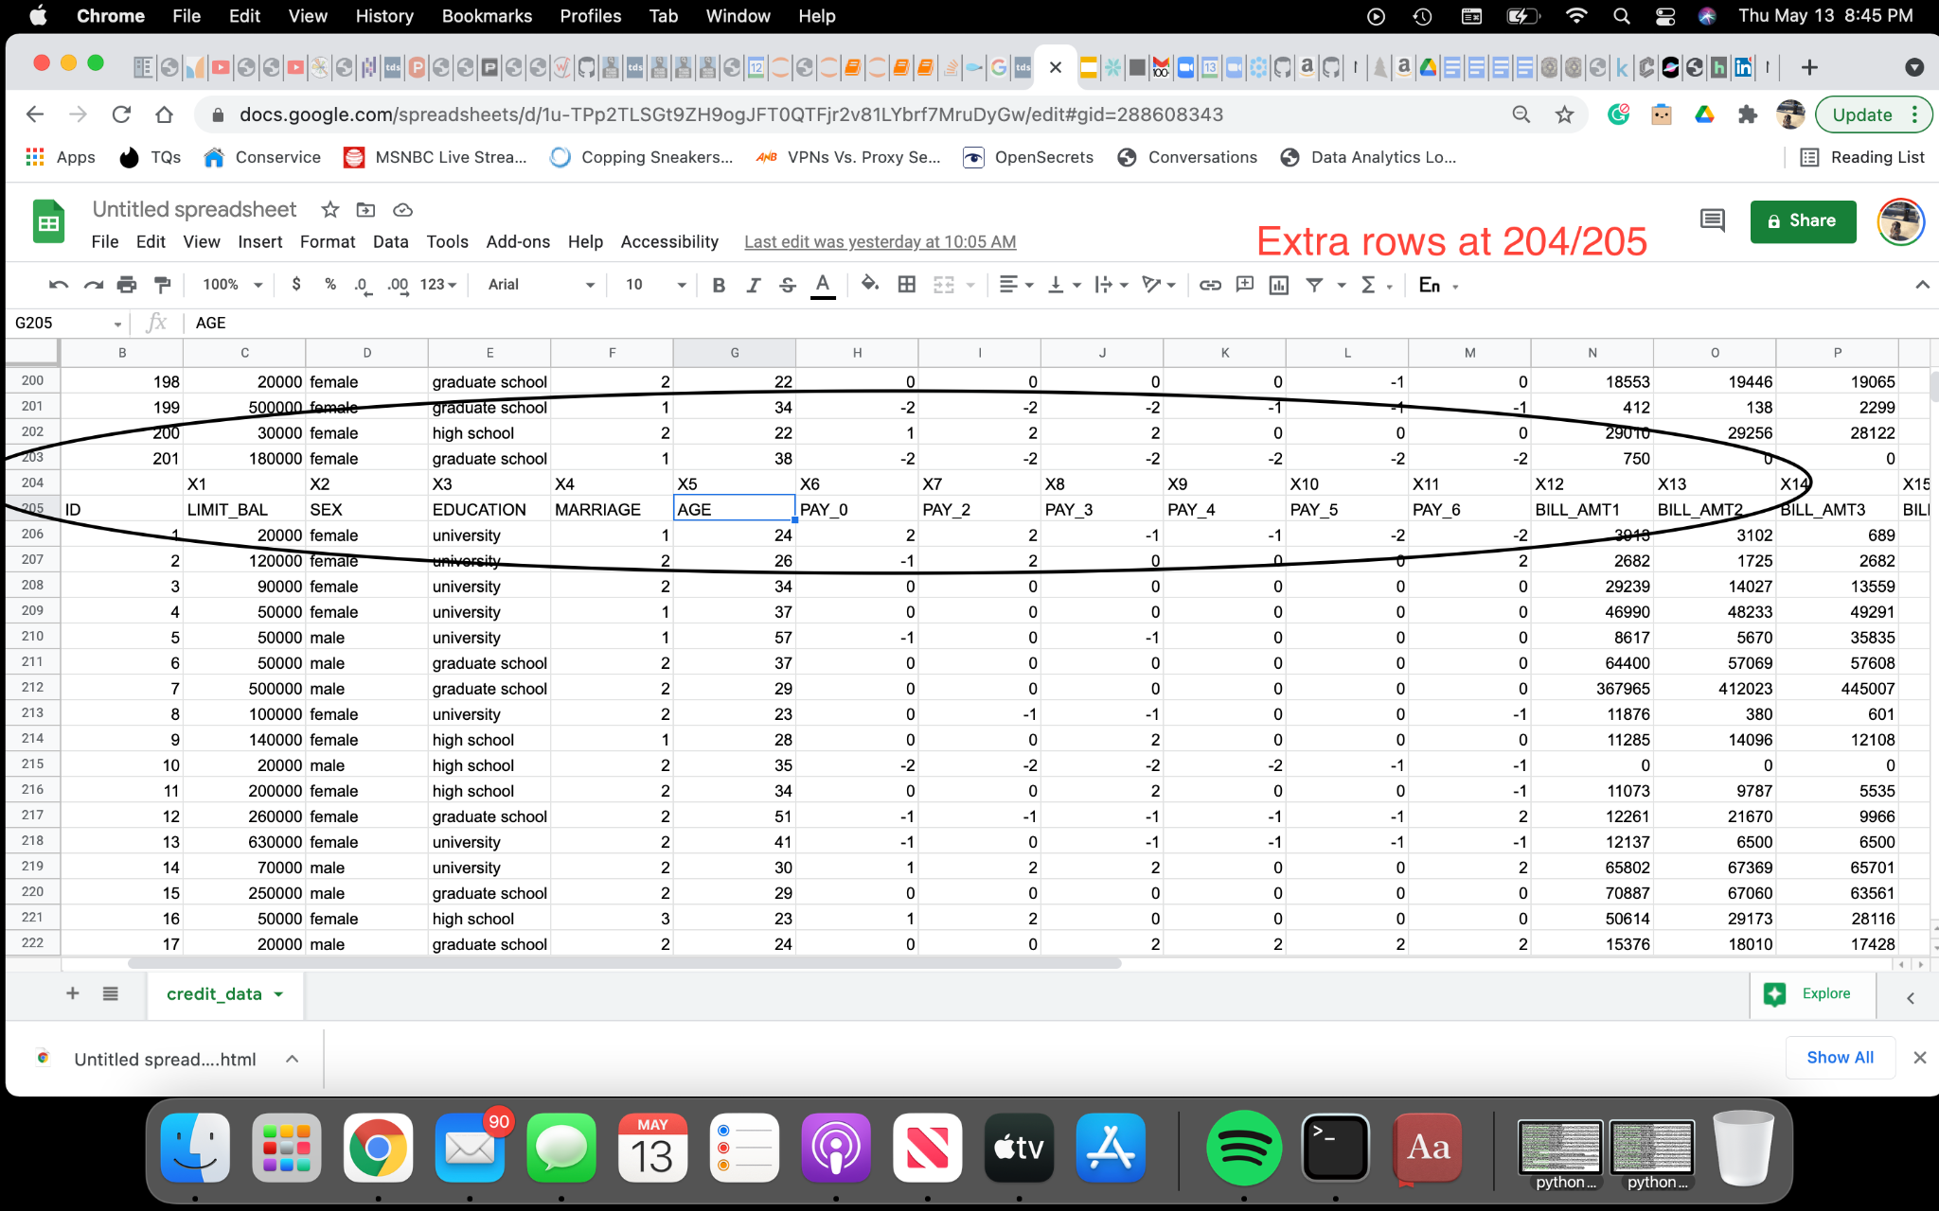
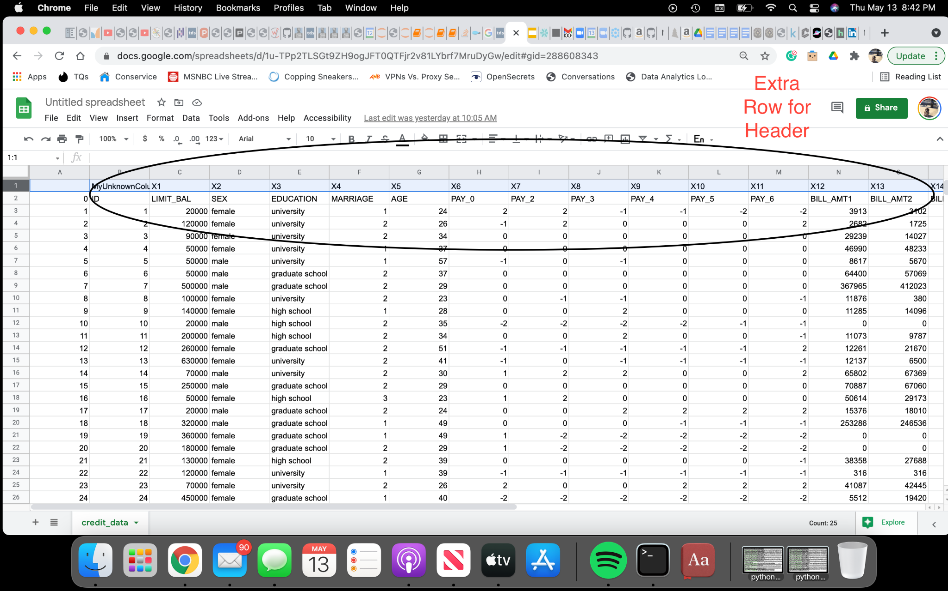
Known Data Issues
There are currently several issues occurring with the data. First there is an extra header (row 0) which can be removed and replaced with the existing header, there are duplicate headers at row 204 and row 205 that can be removed. Additionally the data will need to be converted to numeric as opposed to its current object data type. Finally, an extra column exists before x1 that needs to be removed.

Slide 6
Data Analysis Flow Chart
Collect, Clean, and Convert Data to Workable Format
Make Business Recommendations Based on Observations
Use Machine Learning to Determine Relationships Between Features
Make Observations About the Results from the Analysis

Slide 7
Initial Insights
We have been given a robust data set containing information regarding Limit Balances, Marriage, Education and Age, with whether or not a loan was defaulted, and bill amount/payment information from the loan. We should be able to determine a great deal of information from this data set.

